Slide 1

Fake Product Review Detection
Shreyas Mhatre - 23106135
Parth Shah - 23106087
Krish Sharma - 23106115
Varun Panchal - 23106050
Project Guide
Ms. Tejashri Kolhe
Academic year 2024-25
Notes:
1

Slide 2
Outline
Introduction
Literature Survey of the Existing Systems
Limitations of the Existing Systems
Problem Statement
System Design
Technologies and Methodologies
Implementation Screenshots(Partial )
Conclusion
References

Slide 3
Introduction
Overview:-
We all rely on online reviews to make decisions—whether it’s picking a restaurant, booking a hotel, or buying a product.
But not every review is real. Some are fake, designed to mislead and manipulate ratings.
That’s where our Fake Review Detector comes in. Just paste a review, and our model will analyze it for signs of deception, helping you spot the fakes before they influence your choices.
Stay informed, shop smarter, and don’t let fake reviews fool you
.
Notes:
3

Slide 4
Literature Survey of the Existing System
Survey of Existing Work -
Authors | Year | Paper Title | Summary
Rami Mohawesh , Shuxiang Xu , Son N. Tran , Robert Olligton Matthew Springer , Yaser jararweh , And Sumbal Maqsood | 2021 | Fake Review Detection | The paper surveys fake review detection methods in e-commerce, comparing traditional machine learning and deep learning techniques, analyzing features, datasets, and model performance, and suggesting future research directions.

Slide 5
Authors | Year | Paper Title | Summary
Mohammed Ennaouri and Ahmed Zellou | 2023 | Machine learning approaches For Fake Review Detection | The paper presents a systematic literature review on machine learning methods for detecting fake reviews, highlighting supervised learning as the most used approach, with key challenges including limited datasets, evolving spam tactics, and platform-specific detection limitations.

Slide 6
Limitations of the Existing Systems
Insufficient cross-domain datasets.
Emerging threat of AI-generated fake reviews.
Lack of interpretability in deep learning models

Slide 7
Problem statement
Problem:-
Online reviews influence consumer decisions ,
AI-generated and fake reviews reduce review reliability.
Fake reviews mislead buyers, boost ratings unfairly, and harm competitors.
Current detection methods (rule-based, ML) struggle with evolving fraud techniques.
Solution:-
The project aims to build a local fake review detector using a pre-trained LLM via Olama.

Slide 8
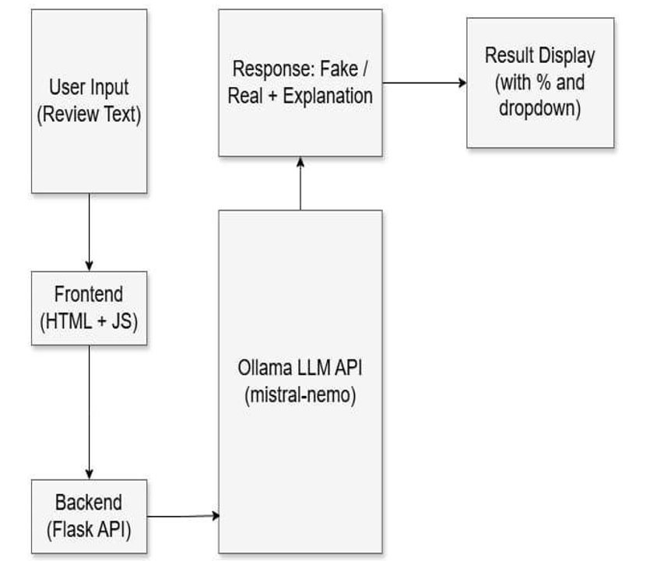
System Design
Notes:
8

Slide 9
Overview of System Design
Input: User pastes a product review into a text box.
Processing:
Review is sent to a local AI model (Ollama) via an API call.
Model analyzes the review to determine if it’s fake or AI-generated.
Output: Displays results indicating if the review is genuine or fake.
Notes:
9

Slide 10
Technology Stack
Programming Language: Python, html, css, js
Framework: Flask (Web-based application)
Model: Ollama locally hosted AI model running on GPU
Hosting: Localhost or internal network for demonstration
Notes:
10

Slide 11
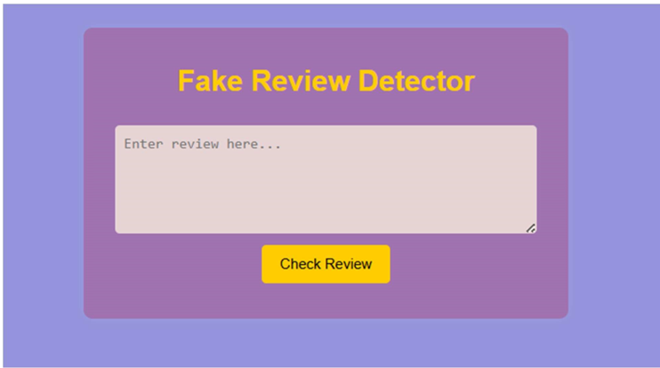
Implementation of Front End
Notes:
11

Slide 12
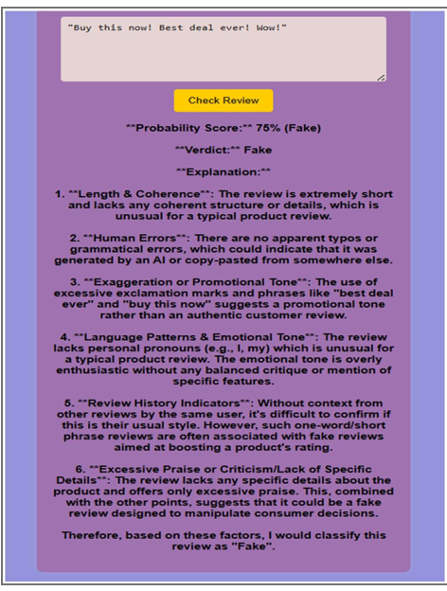
Result after fetching input/review
Notes:
12

Slide 13
Conclusion
Detecting fake reviews is key to trust in e-commerce.
AI-generated fraud is outpacing traditional detection.
Focus on scalable, real-time, offline-capable systems.
Advancements will boost review reliability and trust for users and businesses.
Our model will detect the fake review posted on sites

Slide 14
References
Rami Mohawesh , Shuxiang Xu , Son N. Tran , Robert Olligton
Matthew Springer , Yaser jararweh , And Sumbal Maqsood
Jindal, N., & Liu, B. (2008). Opinion Spam and Analysis. Proceedings of the 2008 International Conference on Web Search and Data Mining (WSDM), 219–230
Vaswani, A., Shazeer, N., Parmar, N., Uszkoreit, J., Jones, L., Gomez, A. N., ... & Polosukhin, I. (2017). Attention Is All You Need. Advances in Neural Information Processing Systems, 30.
https://ieeexplore.ieee.org/abstract/document/9416474
https://link.springer.com/article/10.1007/s10115-024-02118-2

Slide 15
Thank You...!!
Notes:
15

